Slide 1

eHealth Access:
Medunova Search Engine

Slide 2
What is our Project
Goal:
Create chatbot with search engine
Answer simple questions about prescription medication
Easy to use
Capabilities:
Questions are automatically referenced to the drug being viewed.
Answer questions in a human-like manner so that it is easier to understand
Chatbot is interactive on the webpage with easy to understand styling and text
Email functionality built-in, user can receive email of the chat box transcript
Full Stack Development:
Back-end search algorithm design and testing
Front-end wordpress integration and API calls

Slide 3
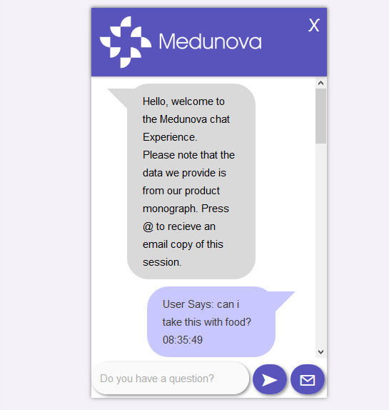
Notable Features: User Interface
Overview:
The Front End component of our Project
Composed of search bar text forms, submission buttons, and a visual of search engine results
The visual shows user searches and engine results as if it were a text messaging system
Messages are formatted so it’s like a real person is talking
Concepts Employed:
HTML - Used to contain main document elements
CSS - Apply styling, to document elements (text bubbles)
PHP - Server side processing; managing data stored (account details) and obtained (results)
JAVASCRIPT AND JQUERY - Client side actions such as showing and hiding the interface
AJAX - Communication between client and server

Slide 4
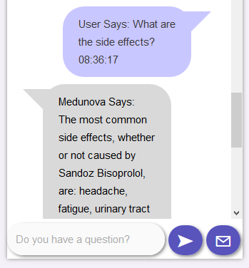


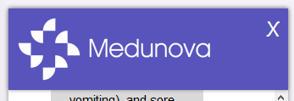
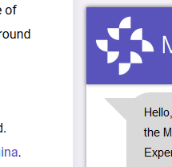
In Depth Feature Review:
Initial and Integrated Search Bar
Email Functionality
Text Bubbles
Showing and Hiding
Responsive Design
Intuitive Appearance
User Interface Cont.

Slide 5
Notable Features: Search Algorithm
Overview:
Created a search algorithm that is capable of handling simple medical questions
Have an answer formatted to be more like a human response, and have a back-up answer in the case that an answer cannot be found
Process:
Find keywords from the user input that will lead the search algorithm to finding an answer
Keywords are matched and looked for within the product monograph
Sentences that contain or are related to the keyword are extracted from the monograph to narrow down the search
Organize the questions into one of three categories
True/False Questions
Quantitative Questions
Use Questions

Slide 6
Answer Question:
Based on another set of keywords for true/false questions
Under ascertain headers for specific questions like “dosages” and “use”
Formatting questions based on category and keywords
Attempt to formulate an answer in the most human-like way possible
This was handled in different ways for each category of questions
The search removes any words that may or should not be included in a typical response
Handling inputs that may not be grammatically correct to the best of the algorithms ability
Style:
The search algorithm is written to be expanded upon, allowing the incorporation of different monographs and unique products
In the event where more direct questions that need to be handled in a different fashion appears, the code can be adapted
Likewise, a new category with different keywords can be created to help manage new questions not previously handled
Search Algorithm Cont.

Slide 7
Notable Features: Email Transcript
Overview:
Developed a feature allowing patients to receive a transcript of their conversation with the Medunova chat bot via email.
Formatted the email to resemble the chat style.
Process:
Obtain the user’s email address
The user has to be logged in to use Medunova so we obtain the email address of the current user’s account
Format the email body
Email is formatted to look like the chat style with proper alignment and full details.

Slide 8
Send the email
Create a Medunova email account to serve as the sender
Handle cases where the email could not be successfully sent.
Style:
The email Sender was written as a class so it could be reused in the future as part of other features.
User Interface Cont.

Slide 9
Team Process
Communications:
Discord was the one of the main tools used for communication between the team members
Slack was used to communicate with the product owner and set-up meetings
Zoom held weekly meetings to update product owner on progress and difficulties
Processes:
Spikes were used to research the project requirements and create a guideline for the code
User Stories were developed as we researched more on implementing a search algorithm and chat box, also new stories were added by product owner inputs
Standards:
Team meetings were mandatory for sprint updates and weekly reviews
Update progress to the team members was done through meetings or messages on Discord
Techniques:
Splitting the team into front-end and back-end developers helped progress the code while still being able to help each other
Used Mockito to test code reliant upon unfinished user-stories

Slide 10
Individual Contributions:
Back-end search algorithm - Ian / Rayon
Back-end mailing systems - Tomiwa
Front-end chat box design - Miguel
Connection - Mark
Process and Standards

Slide 11
System Architecture
Three Tiered Architecture:
Web Server
Wordpress runs the view compiling all code for the search bar
Search bar is written in PHP, Javascript, HTML and CSS for styling
Application Server
Back-end code with search algorithms
Text files used to aid the search algorithm
Written in PHP
Wordpress File
Used to store/gather files according to application needs
Stores the product monograph in an accessible domain for the pdf parser to open

Slide 12
Technologies and Challenges
PHP - coding for both back-end and front-end and the connection between the two.
Used Object Oriententated Programming (OOP) to connect the code easily
Imports and composer to handle the pdf file conversion
I/O to handle pdf and text files to aid in the search algorithm
Learning a new language with similarities with C, Python and Java
WordPress
Compiled all our code as a plugin file
Worked in parallel with other plugin files and code to display the website
Learning the needs for a wordpress plugin to compile
Using JQuery and Ajax-Search plugin to connect files and user inputs
Adding files that didn't interfere with the webpage using FTP

Slide 13
File Transfer Protocol
Used to add files into WordPress so code can be tested
Easy handling and viewing of all our files that are currently deployed on the website
Accessing wordpress files
CSS styling and HTML
Used to create and style chat box with product owners preference of font and colours
Allows the chat box to adapt to screen sizes and stick through scrolling
Learning the language
JQuery
Used to connect the chat box with back-end scripts
Email button works based on JQuery input
Search Algorithm relies on JQuery to receive user questions
Learning and implementing JQuery
Errors when running in a PHP script
Technologies and Challenges

Slide 14
Question and Answer

